Slide 1

|| Azure project 2 ||
Integrating Grafana with Azure VMs
This presentation explores different methods to integrate Grafana with Azure Virtual Machines, enabling powerful monitoring and visualization capabilities for your Azure infrastructure. We'll cover installation, configuration, and best practices for maximizing the benefits of this integration.
Created By- || SANRACHNA YANTRA GROUP ||
1.Amber Agarwal (Team Leader)
2.Radhika Maggo
3.Aditya Ojha
4.Akshat Vishwakarma

Slide 2
Installation Methods
Grafana on Azure VM
External Grafana
Install Grafana directly on an Azure VM, providing full control over its configuration and resources.
Connect to an existing Grafana instance hosted externally, leveraging its pre-configured features and centralized access.

Slide 3

Installing Grafana on the VM
1
1. Choose a VM
2
2. Install OS
Select a VM type and size suitable for your Grafana needs.
Deploy the VM with a supported Linux distribution, like Ubuntu.
3
3. Install Grafana
Install Grafana using a package manager or by downloading the binaries.

Slide 4
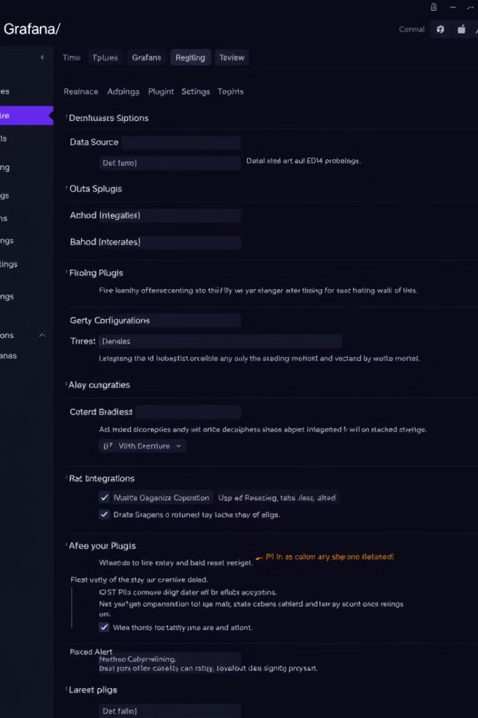
Configuring Grafana
Access Settings
Define Dashboards
Set up user authentication, data source connections, and notification preferences.
Create dashboards with visualizations, widgets, and panels to display collected data.
Configure Plugins
Install and configure plugins to enhance functionality and data analysis.

Slide 5




Connecting to Azure Services
Azure Monitor
Collect metrics, logs, and traces from Azure services for comprehensive monitoring.
Azure SQL Database
Monitor performance and resource usage of your Azure SQL databases.
Azure Storage
Track storage capacity, access patterns, and performance for your Azure storage accounts.

Slide 6

Visualizing Data
1
Graphs
Display data trends and patterns over time using line, area, and bar graphs.
2
Charts
Visualize data relationships using pie charts, donut charts, and heatmaps.
3
Tables
Present raw data in tabular format for detailed analysis and reporting.
4
Maps
Visualize geographically distributed data using interactive maps.

Slide 7




Automating Configuration
Configuration Management
Use tools like Ansible or Terraform to automate Grafana installation and configuration.
Infrastructure as Code
Define your Grafana infrastructure using code, ensuring consistency and reproducibility.
Continuous Integration/Continuous Delivery (CI/CD)
Integrate Grafana deployments into your CI/CD pipelines for seamless updates.

Slide 8




Securing the Integration
Authentication
1
Implement user authentication to control access to Grafana and the Azure VM.
2
Authorization
Restrict user permissions based on roles and responsibilities.
3
Encryption
Secure sensitive data transmitted between Grafana and Azure services.
Firewall Rules
4
Configure network security groups to restrict access to the Grafana instance.

Slide 9
Monitoring and Alerting
Real-Time Monitoring
1
Track performance metrics and system health in real-time.
Alerts
2
Set up alerts to notify you of critical events or deviations from expected behavior.
Troubleshooting
3
Use Grafana dashboards to diagnose issues and gather information for problem resolution.

Slide 10

Best Practices and Troubleshooting
1
Optimize Performance
Ensure sufficient VM resources and network bandwidth for optimal Grafana performance.
2
Security Best Practices
Adhere to security principles to protect sensitive data and prevent unauthorized access.
3
Documentation
Document configuration settings and deployment procedures for future reference.

